Slide 1
Notes Nuclear Chemistry

Slide 2
Stable vs Unstable

Slide 3
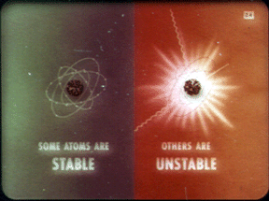
What is a stable atom?
A stable atom has a nucleus with the right number of neutrons to keep the positive protons from breaking apart.
Most atoms in our environment are stable (won’t break apart)

Slide 6
What is a stable Atom?
Elements with atomic numbers 1-20 have equal # of neutrons to protons
Elements with atomic numbers > 20 have more neutrons than protons
Elements with atomic numbers > 83 are all unstable
(Nucleus will break apart) and are radioactive

Slide 7
Nuclear Stability
Decay will occur in such a way as to return a nucleus to the band (line) of stability.

Slide 8
What is the strong nuclear force?
What is the strong nuclear force?
The force neutrons have that keeps the positive protons together.

Slide 9
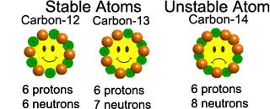
What are radioisotopes?
Radioisotopes are unstable isotopes of elements of any atomic number
The nucleus will break apart and release radiation

Slide 10
Parent
Nucleus
Daughter
Nucleus
Radiation
Particle

Slide 11
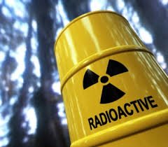
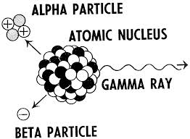
What is radioactivity?
The emission (or release) of radiation from an unstable atom as the nucleus breaks apart

Slide 12
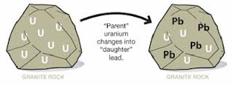
What is radioactive decay?
The nucleus breaking apart, becoming a different element and releasing radiation
Also called nuclear reactions

Slide 13
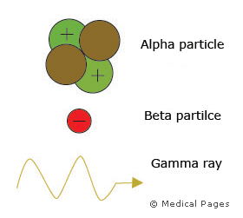
What are the types of Radiation?
When a nucleus breaks apart it can release one or more of the following:

Slide 14
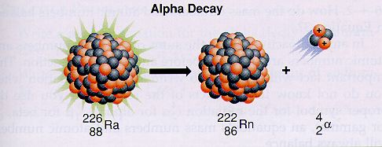
Alpha
Alpha Radiation (Decay) -
Parent nucleus ejects 2 protons and 2 neutrons called the alpha particle
Daughter nucleus has atomic # decrease by 2 and mass # decrease by 4

Slide 15
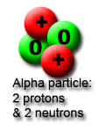
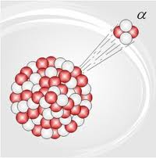
Alpha
Alpha particle
Identity: helium-4 nuclei
Charge: 2+
Symbol: ⁴₂He or ⁴₂α

Slide 16
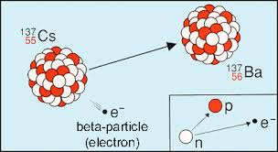
Beta
Beta Radiation (Decay)
Parent nucleus ejects an electron called the beta particle
One neutron becomes a proton, creating the ejected electron from inside the nucleus
Daughter nucleus has atomic number higher by 1
no change in mass

Slide 17
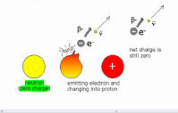
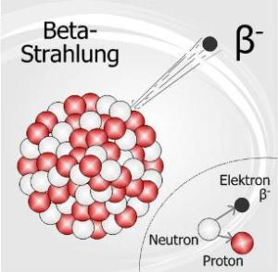
Beta
Beta particle
Identity: high-speed electron
Charge: 1-
Symbol: ⁰₋₁e or ⁰₋₁β

Slide 18
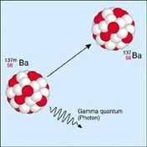
gamma
Gamma Radiation
Pure energy released with alpha and beta radiation
Does not effect atomic number or mass of daughter nucleus

Slide 19
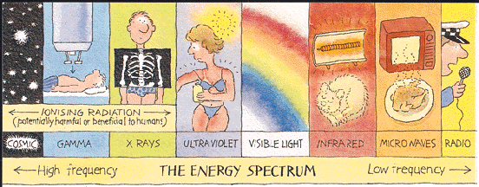
gamma
Gamma Ray
Identity: high energy light wave, No particles
Charge: none
Symbol: ⁰₀γ

Slide 20
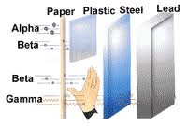
What is the penetrating ability and health hazard?
Alpha particles: low, stopped by paper
Only dangerous if swallowed

Slide 21
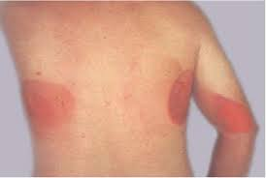
What is the penetrating ability and health hazard?
Beta particles: medium, stopped by heavy clothing
Can damage skin

Slide 22
What is the penetrating ability and health hazard?
Gamma Ray: high, stopped only by lead
Can cause body cell damage
–result cancer
Can cause reproductive cell damage
- result children malformed

Slide 23
Gamma radiation and cancer treatment

Slide 25
Summary – for you to complete

