Slide 1
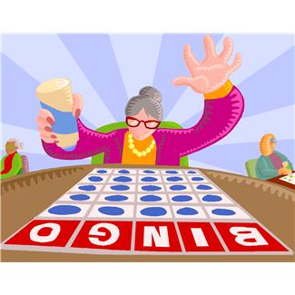
Review Bingo!

Slide 2
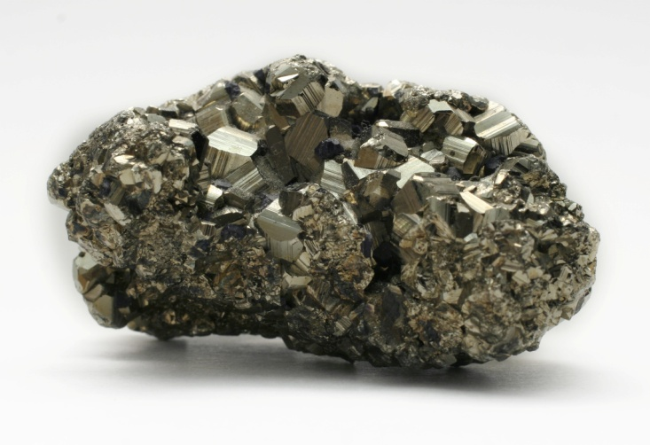
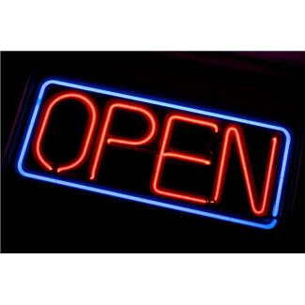
What vocabulary word refers to compounds and elements that have matter?
Bonus Question-
Could salt water be a substance? Why or why not?

Slide 3
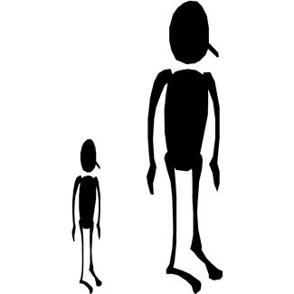
Characteristics and attributes that are usually observable are called ______.
Bonus Question-
Give another example of this vocabulary word besides the height of someone.

Slide 4
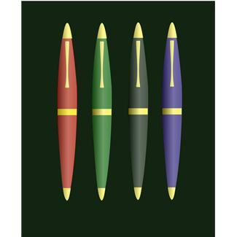
This property can be observed or measured.
Bonus Question-
Would saying that something “is” blue be a physical or chemical property?

Slide 5
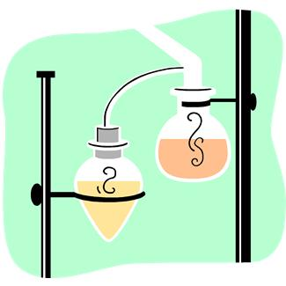
To find out this property you have to make react with other chemicals.
Bonus question-
Would the ability to catch fire (flammability) be an example of this property?

Slide 6
This type of change only alters an object’s appearance.
Bonus Q-
If I were to burn paper what type of change would that be?

Slide 7
Double Bonus…(NOT on your bingo card)
What is the chart called with all of the elements in it?

Slide 8
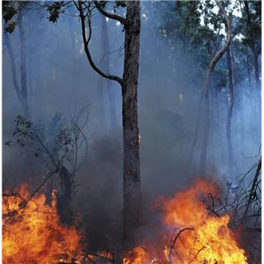
This type of change alters the chemical composition of the object.
Bonus Q-
From lab, what item had a chemical change?

Slide 9
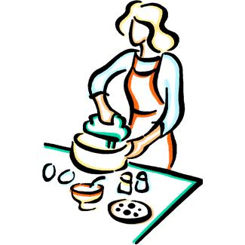
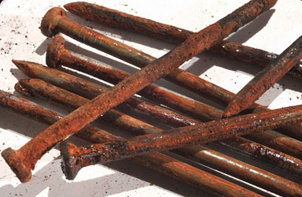
In the end, a cake will be made. What states new physical and chemical properties are formed?
Bonus Q-
What do we use in chemistry to “show” a chemical reaction?

Slide 10
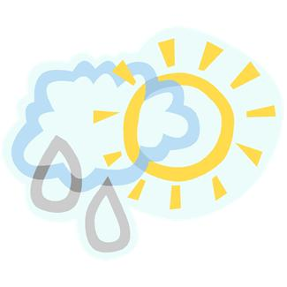
What “law” states that nothing is created or destroyed?
Bonus Q-
If nothing is created or destroyed what happens to it?

Slide 11
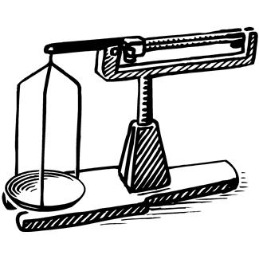
All matter has this. Can be measured using a balance.
Bonus Q-
What is the difference between weight and mass?

Slide 12
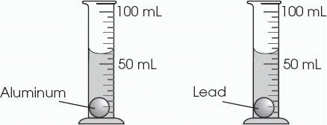
If something has both mass and volume it is called ______.
Bonus Q-
Name three things that are not matter.

Slide 13
Double Bonus…(NOT on your bingo card)
Pasta absorbing water (during cooking) is which type of change AND which type of mixture?

Slide 14
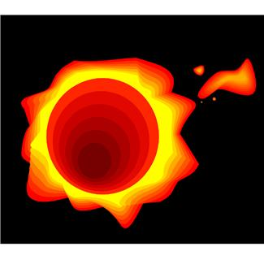
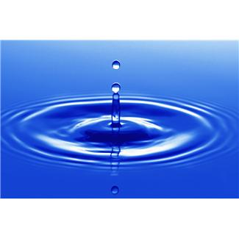
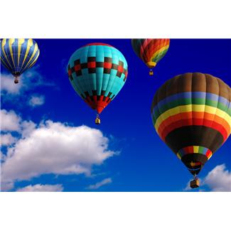
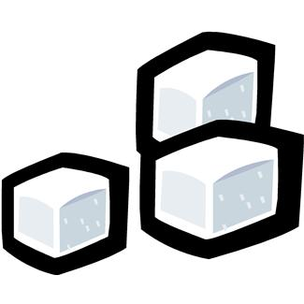
There are four of these!
Bonus Q-
Which of these are the three most common?

Slide 15
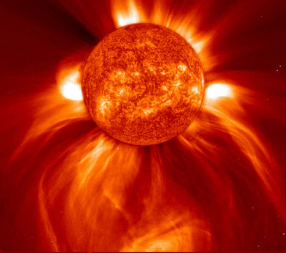
The sun and lightning emit this state of matter.
Bonus Q-
Does this state of matter move faster or slower than gas?

Slide 16
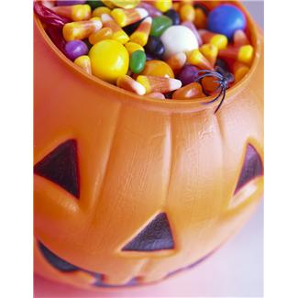
This state holds a particular shape and volume.
Bonus Q-
What could you do to change the “state” of this candy?

Slide 17
This state does NOT hold its own shape, but has a definite volume.
Bonus Q-
When gas turns into a liquid, what is that called?

Slide 18
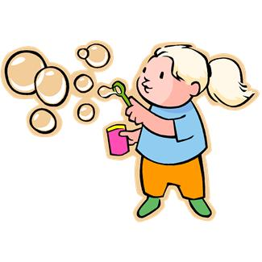
This state has NO definite volume or shape.
Bonus Q-
Name one other gas or give me the chemical symbol for a gas.

Slide 19
Double Bonus…(NOT on your bingo card)
What element on the periodic table did I say was “special”? (Hint- it is a gas that the sun burns up.)

Slide 20
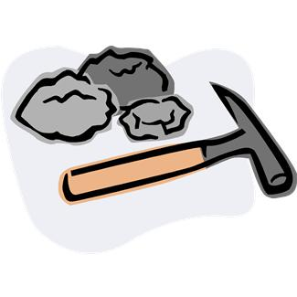
This is the purest form of a substance.
Bonus Q-
From lab, would an Al (aluminum) staple be pure?

Slide 21
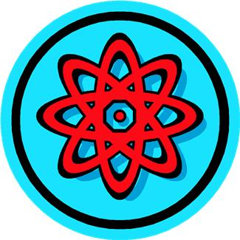
This is the smallest part of a pure substance.
Bonus Q-
If I had two of the same ones of these together- we would call it a ________.

Slide 22
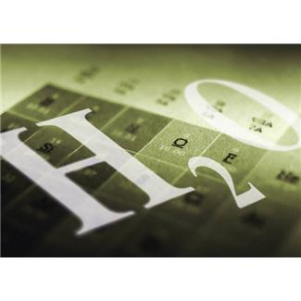
A chemically changed bond of two or more atoms is called a _______.
Bonus Q-
Would N2 be a compound, molecule, or both? (Nitrogen is a gas)

Slide 23
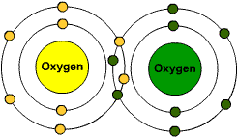
When two atoms bond together (such as O2) what does it form?
Bonus Q-
Can all molecules be called compounds? Why or why not?

Slide 24
Double Bonus…(NOT on your bingo car)
Which type of mixture can we use filtration to separate the substances?

Slide 25
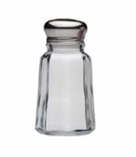
Matter with a unique set of chemical and physical properties is classified as a ________ substance.
Bonus Q- Which type of mixture could be a pure substance? Why?

Slide 26
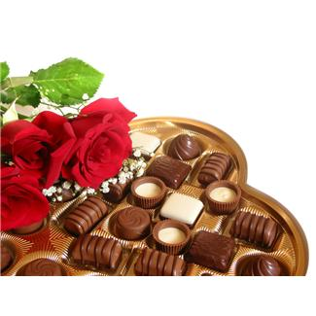
You can have a heterogeneous _____ or a homogeneous ______.
Bonus Q-
Can mixtures be made of compounds or elements?

Slide 27
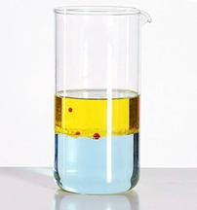
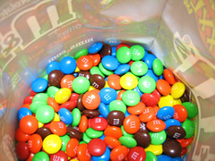
A type of mixture where you can “see” the different substances.
Bonus Q-
Explain how difficult it is to separate this type of mixture.

Slide 28
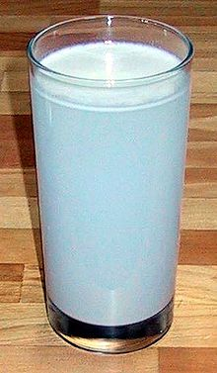
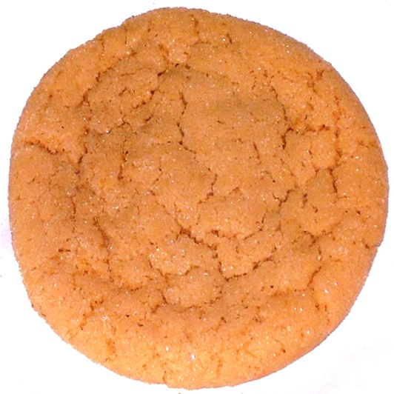
A type of mixture where you visually cannot see the different substances.
Bonus Q-
Can this type of mixture be separated?

Slide 29
Double Bonus…(NOT on your bingo card)
What is the most common question you ask yourself when you are trying to decide if it is a physical or chemical change?

Slide 30
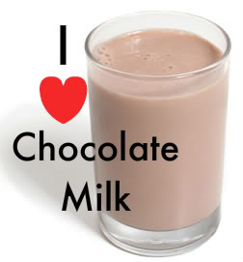
A homogeneous mixture of two or more substances in a single physical state.
Bonus Q-
How can you make it look like two substances are one?

