Slide 1
Elements, Compounds or Mixtures

Slide 2
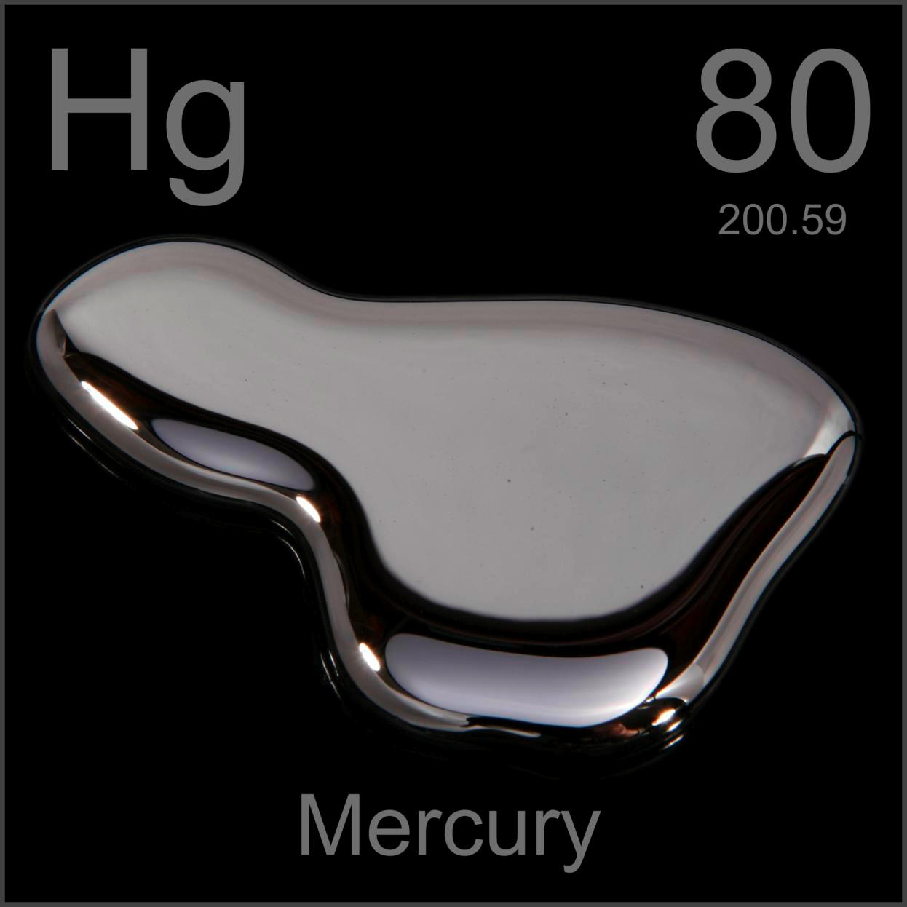
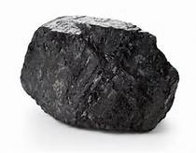
What is an Element?
A pure substance made up of only one kind of atom

Slide 3
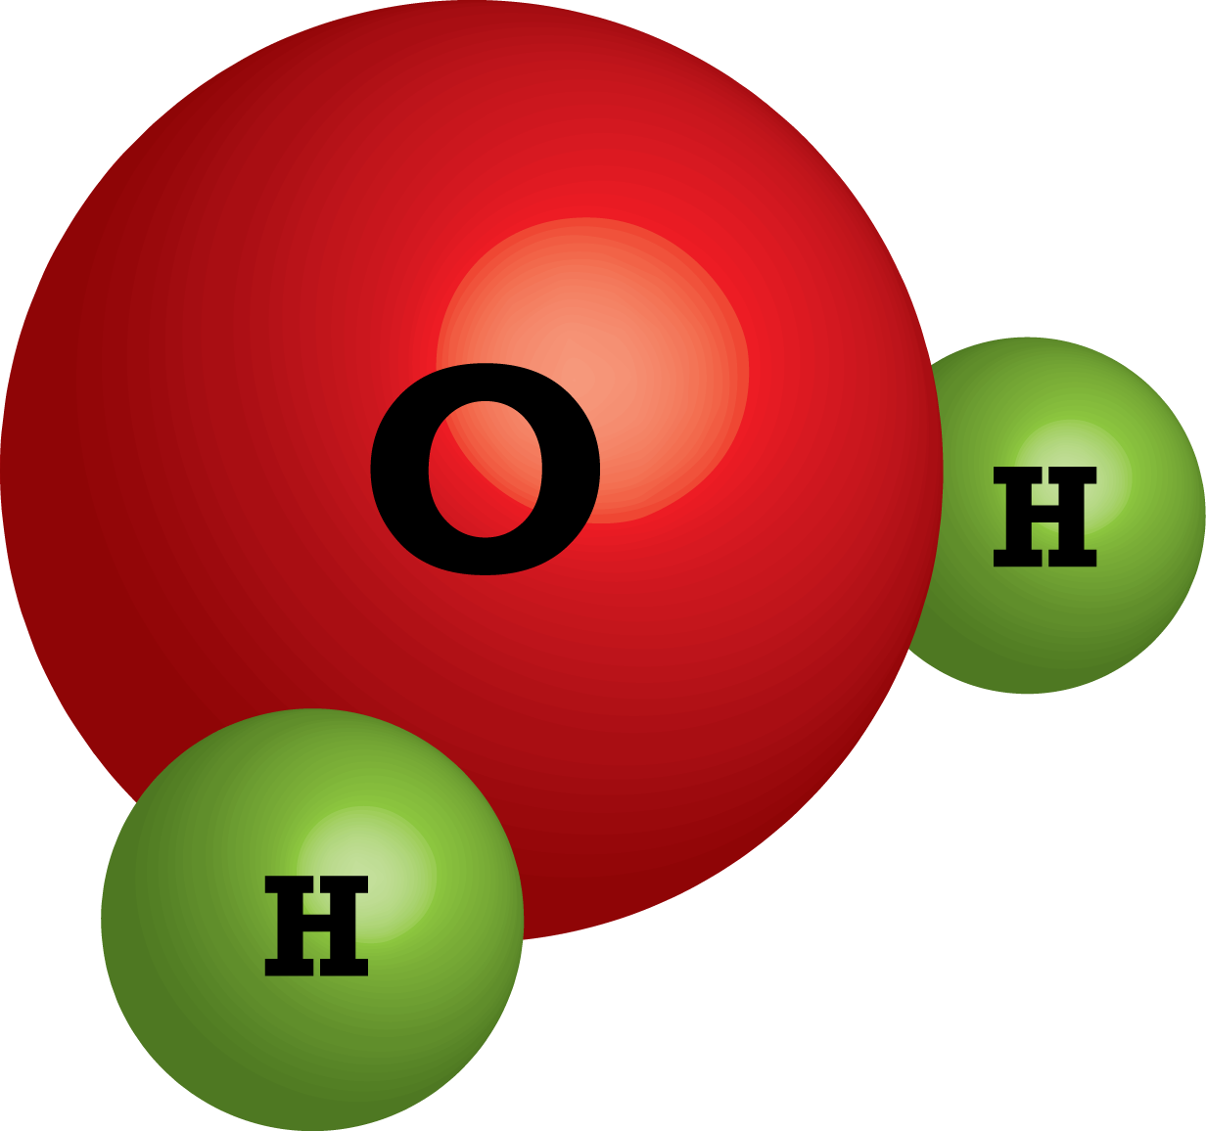
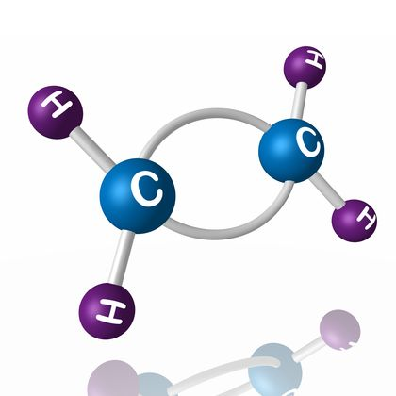
What is a Compound?
A substance made from the atoms of two or elements that are chemically bonded

Slide 4
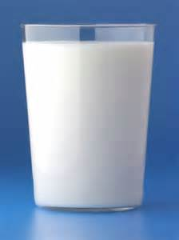
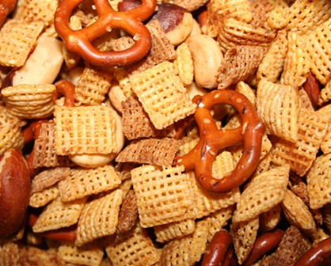
What is a Mixture?
A blend of two or more kinds of matter

Slide 5
What is this?

Slide 6
What is this?

Slide 7
What is this?

Slide 8
What is a pure substance?
Made of only one type of matter.
It’s the same throughout the sample.
It has definite properties

Slide 9
What are the types of pure substances?
Elements and Compounds

Slide 10
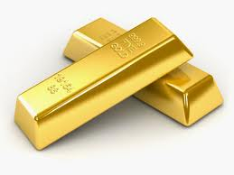
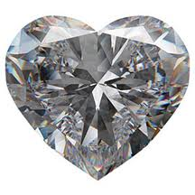
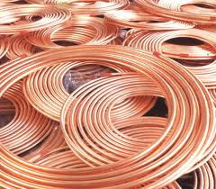
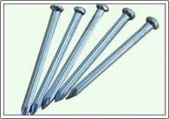
What is an Element?

Slide 11
What is an Element?
Elements – matter made of all the same types of atoms
Chart of Elements is called the Periodic Table
Examples: Copper (Cu), Carbon (C), Sodium (Na), Chlorine (Cl)

Slide 13
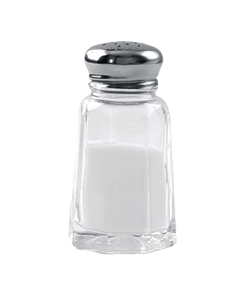
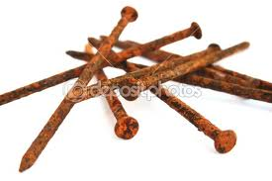
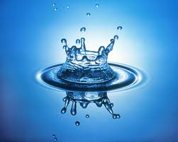
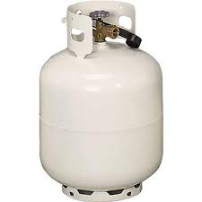
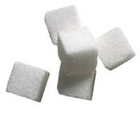
What is a Compound?

Slide 14
What is a Compound?
Compounds – matter made of two or more types of atoms (elements) that are bonded together (also called molecules)
Most matter in the world is in the form of compounds
Examples: Water (H₂O), Sugar (C₆H₁₂O₆)

Slide 15
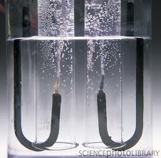
2H₂O ➔ O₂ + 2H₂

Slide 16
How are Elements and Compounds different?
Elements cannot be chemically broken down any further.
Compounds can be chemically broken down into Elements.

Slide 17
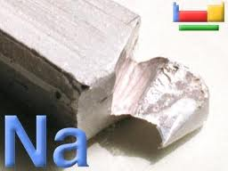
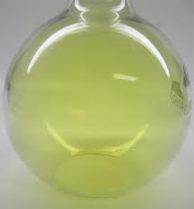
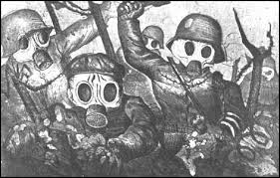
2Na + Cl₂ ➔ 2NaCl
✚
➔

Slide 18
Do elements and compounds have the same properties?
Properties of compounds are different from the properties of the elements they are made of.
Example: Salt is made from sodium metal and toxic chlorine gas

Slide 19
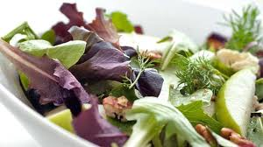
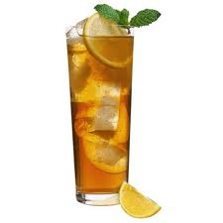
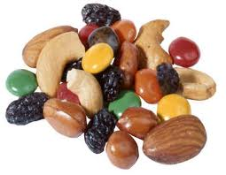
What is a mixture?

Slide 20
What is a mixture?
Two or more substances “mixed” together

Slide 21
Do the parts of a mixture lose their properties?
NO! There is no bonding in a mixture.
The substances in the mixture keep their individual properties.

Slide 22
Can the parts of a mixture be separated?
YES! The physical properties of the substances can be used to separate them from the mixture.
Example: Salt in water – evaporate the water away and get the salt back

Slide 23
What is a mixture?

Slide 24
Are there different types of mixtures?
Yes -
Homogeneous and Heterogeneous

Slide 25
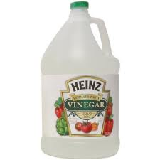
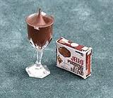
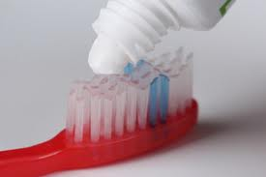
What is a homogeneous mixture?

Slide 26
What is a homogeneous mixture?
The mixture looks the same throughout.
Example: Salt in water – can’t see the salt – looks like clear water
coffee, tea, toothpaste,

Slide 27
What is a solution?
A type of homogeneous mixture, like salt in water.

Slide 28
Is it easy to separate the parts of a homogeneous mixture?
NO! It takes a lot of energy
Example: Salt in water – must boil the water away from the salt

Slide 29
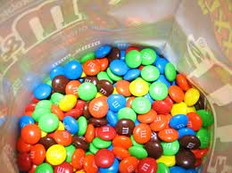
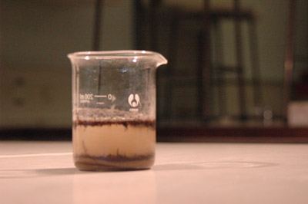
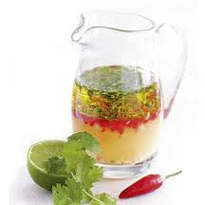
What is a heterogeneous mixture?

Slide 30
What is a heterogeneous mixture?
The mixture does not look the same throughout. You can see the different substances.
Example: Oil and Water, Sand and Water

Slide 31
Is it easy to separate the parts of a heterogeneous mixture?
YES It does not take a lot of energy.
Example: Decant (pour off) the oil way from the water. Filter the sand away from the water.

Slide 32
http://www.bbc.co.uk/bitesize/ks3/science/chemical_material_behaviour/compounds_mixtures/activity/

Slide 33
On bottom of page add: Matter Flowchart
MATTER
yes
no
Can it be physically separated?
MIXTURE
PURE SUBSTANCE
yes
Is the composition uniform?
no
yes
Can it be chemically decomposed?
no
Homogeneous Mixture
(solution)
Heterogeneous Mixture
Compound
Element
Colloids
Suspensions

