Slide 1
Notes- Properties of Ionic Compounds #3
#3

Slide 2
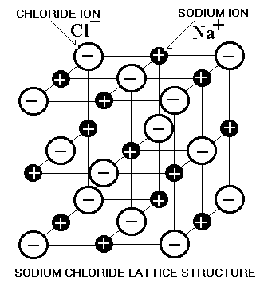
What is the structure of an ionic compound?
Ionic compounds form ___crystalline solids_ of repeating __patterns__ of positive ions (cations) and negative ions (anions).

Slide 3
What is crystal lattice?
Crystal lattice is the repeating patter of __cation to anions__ that forms the solid.

Slide 4
What is the unit cell?
The __smallest part__ of the crystal lattice that shows the repeating pattern is called the unit cell. The crystal __grows__ unit cell by unit cell.

Slide 5
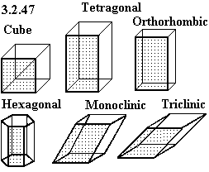
What are the different types of unit cells?
There are 7 basic types of unit cells in crystals:

Slide 6
Continued- Different types of unit cells
Sodium chloride (table salt) is a __cube__ crystal.
Sodium Borate (Borax) is a __monoclinic__ crystal.

Slide 7
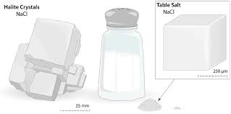
Example- NaCl

Slide 8
Are ionic compounds brittle or malleable?
Ionic compounds are __brittle__. They break (or shatter) along the lines of the ionic bonds
force crystal shatters

Slide 9
Melting Point
Ionic compounds have __high__ melting points (high temperature is needed to make an ionic compound become a __liquid__).
Example- Sodium Chloride melts at 1,474 F (801 C).
This indicates the electrostatic ( + - ) are very __strong__.

Slide 10
Soluble in Water
Many ionic compounds are __soluble (dissolve)__ in water. The solid breaks into __free ions__ that move between the water molecules.

Slide 11
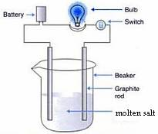
Conduct Electricity
Crystalline solids- __no__
Molten (liquid)- __yes__
Dissolved in water- __yes__

