Slide 1
Guided Notes #2 Ionic Bonding

Slide 2
Ionic bonding with dog bones ☺

Slide 3
Chemical Bonds
These attractions between atoms __bond__ molecules together.
We will be learning about ionic and covalent bonds, but there are more (bonds)!

Slide 4
Ionic Bonds
(Side margin reads:)
Metal + nonmetal= ionic bond
(cation) + (anion)
*You need at least one of each to make an ionic bond*

Slide 5
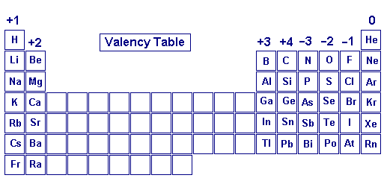
1 element from Group 1,2, or 13 (cation) AND 1 element from Groups 15, 16, or 17 (anion) **Objective- get 8 valence electrons**

Slide 6
Ionic Bonds
Ionic bonds are formed by the electrostatic attraction after the complete __ __ of an electron from a cation to an anion.
The __ __atom attracts the electrons because it is much more electronegative than the cation atom.

Slide 7
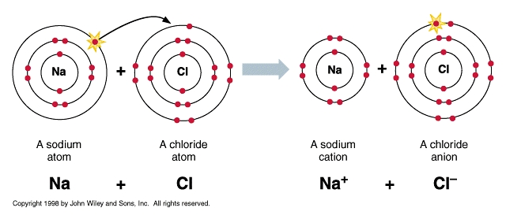
Example- An ionic compound salt

Slide 8
About the picture
The Na atom (a cation) _GIVES_ the Cl atom (an anion) its one valence electron.
The picture on the right shows how BOTH the Na atom and the Cl now have __full/ complete__ valence shells. Both are now __stable__ and complete.

Slide 9
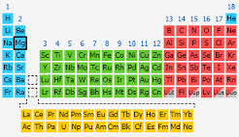
Practice
Mg would like to “give away” its two valence electrons. What group would be a good suggestion (to make an ionic bond)?

Slide 10
Practice
Mg would like to “give away” its two valence electrons. What group would be a good suggestion (to make an ionic bond)?
Answer- anyone in group 16 because you already have 2 valence electrons so you would need 6 more to complete the octet rule (or have 8 valence electrons)

Slide 11
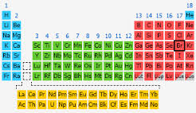
Practice
Br would like to have a full valence shell.
Who could Br “take” an electron from?

Slide 12
Practice
Br would like to have a full valence shell.
Who could Br “take” an electron from?
Answer- anyone from Group 1. Since Br is in Group 17 that means it has 7 valence electrons. It would need just 1 more valence electron to make a full shell (8 electrons).

Slide 13
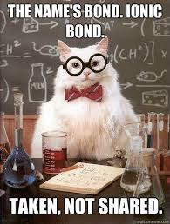
Ionic bonds take vs Covalent bonds share (that’s next week’s lesson)

Slide 14
“I”- think out for “one” self (or one atom needs to be focused on)
Remember “I”onic bond.
It gives and takes, but does not share.

Slide 15
Animation

Slide 16
Review
Electrons Charge | Octet Rule | Cation (group #) | Anion (group #)
Valence Electrons (VE) (location)- | Always stable group? | Types of elements for cations- | Types of elements for anions-

Slide 17
Review
Electrons Charge- negative (-) | Octet Rule- Need 8 valence electrons | Cation (group #) 1, 2, and 13 | Anion (group #) 15, 16, and 17
Valence Electrons (VE) (location)- Outermost energy level/ shell | Always stable group? Noble gases (always has 8 VE) | Types of elements for cations- metals | Types of elements for anions- Non-metals

Slide 18
Label your periodic table
If you want…label your periodic table with the + and – in the next slide.
This tells you how many valence electrons (and if they are positive or negative ion charge) that each group has to GIVE or TAKE.

Slide 19
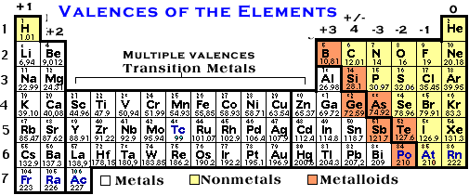
+ cations= metals= Groups 1,2,13 - anions= nonmetals= Groups 15,16, 17

