Slide 1
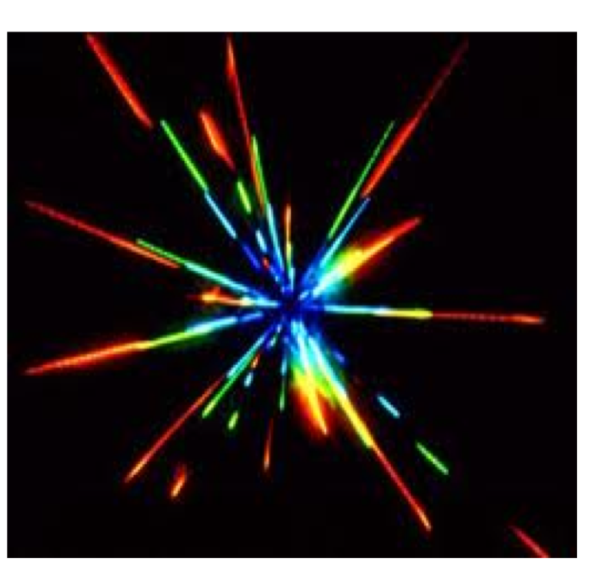
Meet the electron……

Slide 2
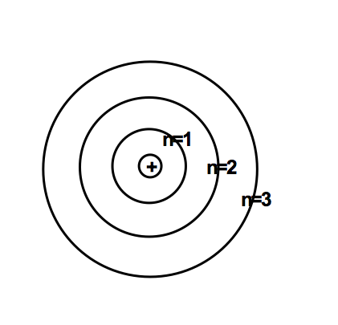
Why did Bohr think electrons are in energy levels around the nucleus?

Slide 3
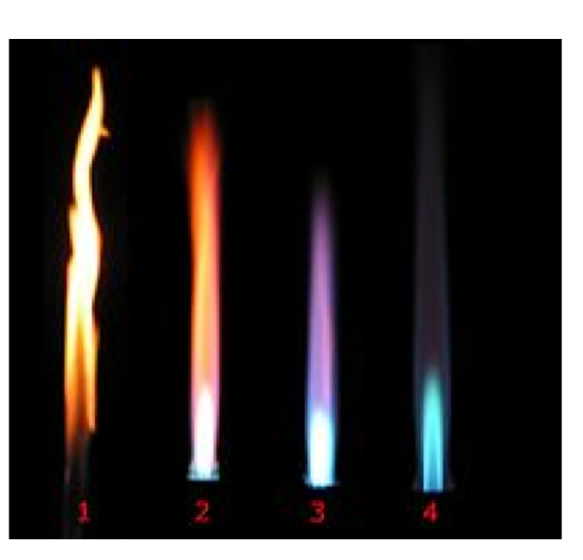
He saw colored light when things burn and wondered why.

Slide 4
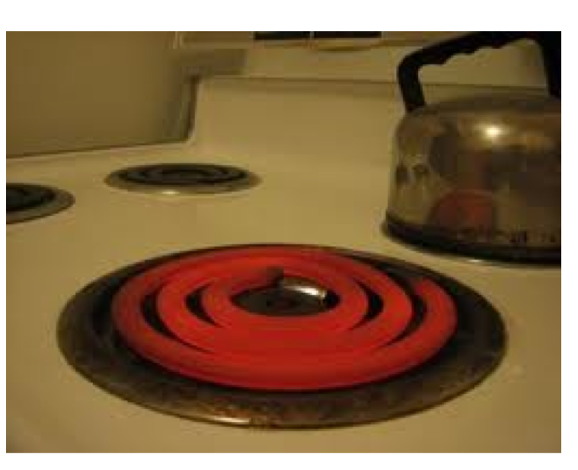

Slide 5
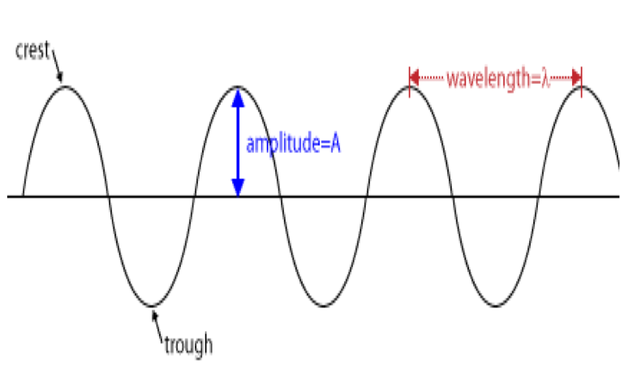
Wavelength and energy: Bohr knew light is a form of energy and light is a wave. Different colors of light have different wavelengths which relate to their energy. **Draw the below diagram of a wave**

Slide 6
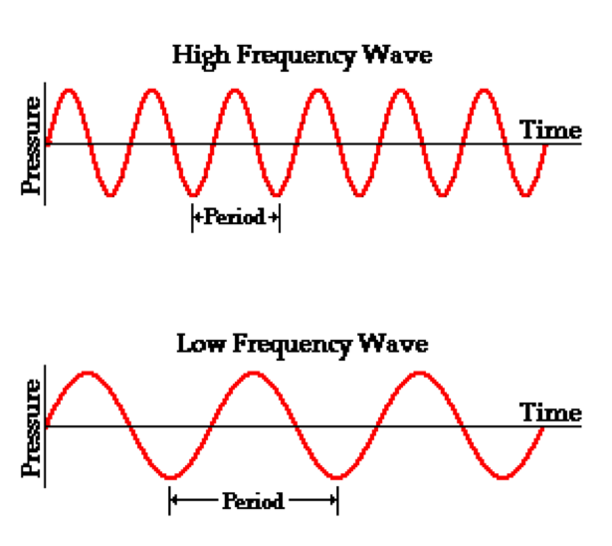
Short wavelengths have more energy. (There are more “waves” in the top one.)

Slide 8
Check for understanding
Which type of wave has more energy gamma waves or radio waves?
2.How can you tell?

Slide 10
Check for understanding
Which type of wave has more energy gamma waves or radio waves?
Gamma
2.How can you tell?
Shorter wavelength

Slide 11
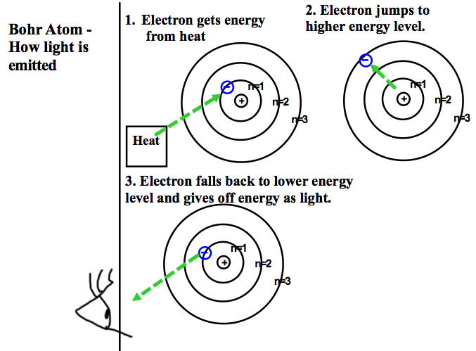

Slide 12
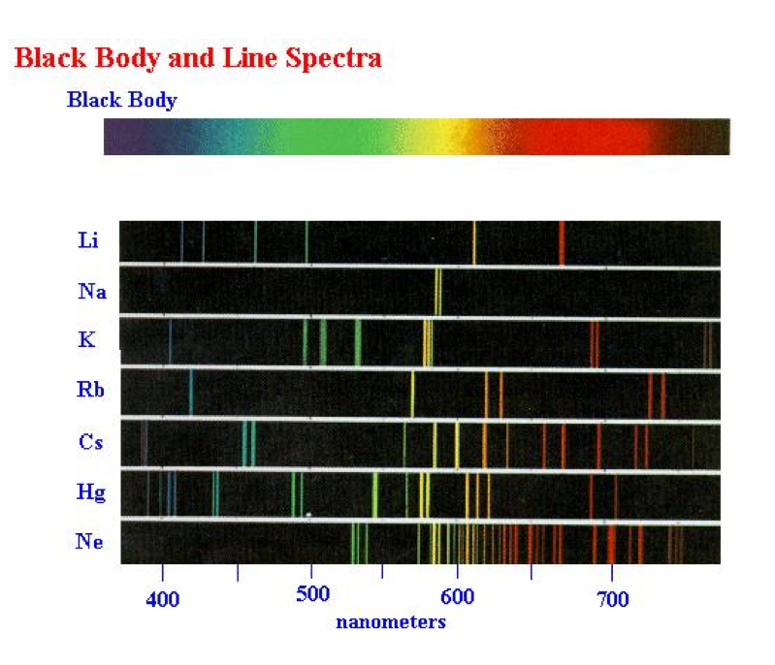
Each element has it’s own light pattern. Can use to ID element.

Slide 13
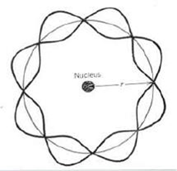
Wave Model of Atom replaces Bohr Model adds energy sublevels called s, p, d, f orbitals.
Wave Model of Atom

Slide 14
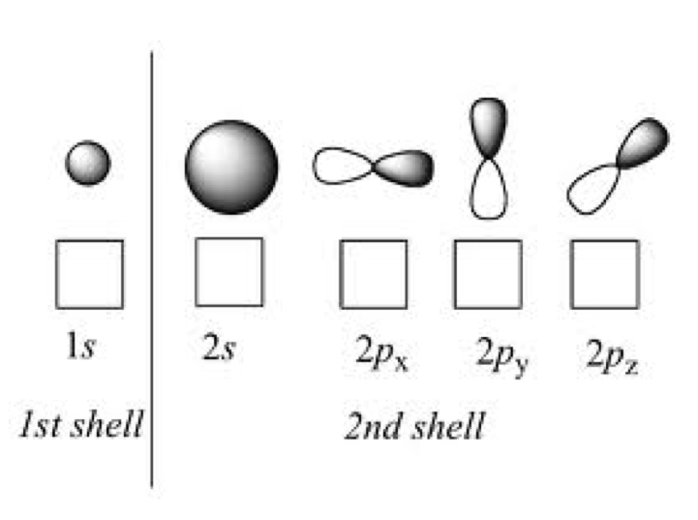

Slide 15
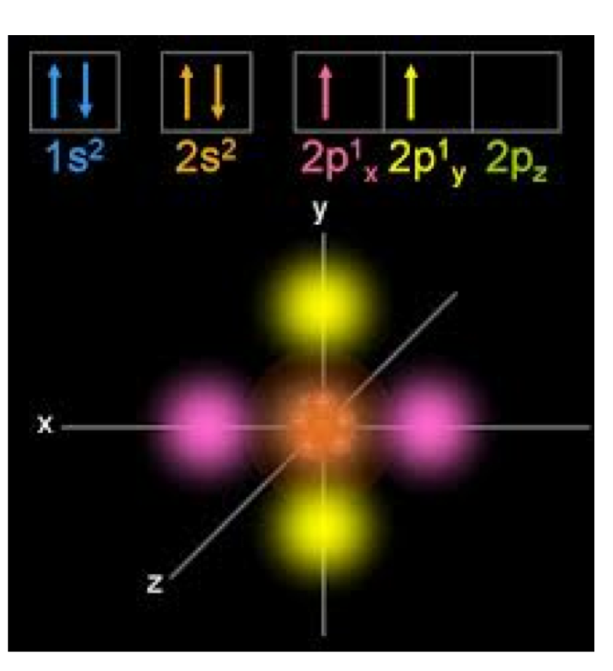

Slide 16
Number of electrons in the energy sublevels
Each sublevel holds a certain number of electrons
Each “s” can have up to 2 electrons
Each “p” can have 2 electrons x 3 p= total of 6 electrons
Example- Li 1s²2s¹
F 1s²2s²p⁵
*The s level must first be filled, then the p level.

Slide 17
Electron configurations are the addresses of the electrons. They list the energy sublevels and the number of electrons in each sublevel for an element.
1s²2s²2p⁶
Energy Level Number of electrons
^{Sublevel}
**The last energy level tells you the Period #- 2 in this example.
Add up the exponents for sublevel 2 only (2+6= 8)- 8 tells us the Group #
-The element is in Group 8, Period 2
Electron Configurations

Slide 18
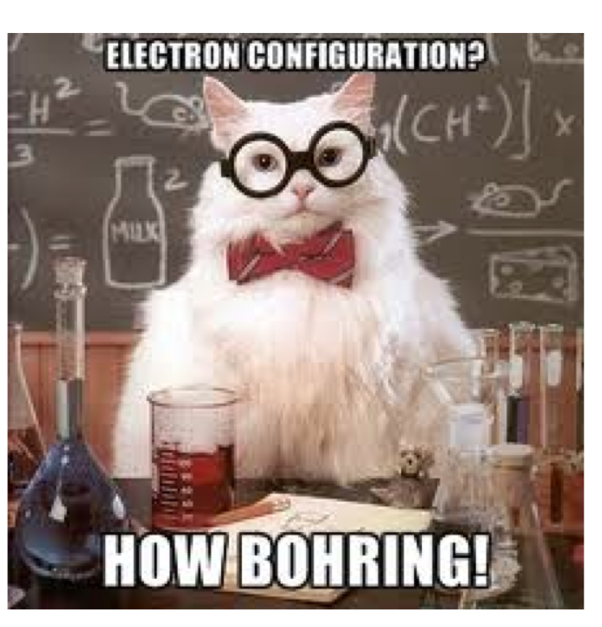

Slide 19
Superscripts/exponents are the number of electrons. Add them together and get the total number of electrons. Use this to ID an element. (Remember APE)
Try it, what element has the following electron configuration?
1s²2s²2p²
Identify the element

Slide 20
Superscripts are the number of electrons. Add them together and get the total number of electrons. Use this to ID an element. (Remember APE)
Try it, what element has the following electron configuration?
1s²2s²2p²
Answer: 6 electrons - Carbon
Identify the element

Slide 21
List the noble gas that comes before the element and complete with the last energy level and sublevels.
Example: [Ne]3s²3p²
To ID the element find Ne and move 4 atomic numbers passed Neon. What element did you find?
***(Add these notes in)***
OR look at the “3” this is the LAST energy level (also the Period #)
Then, look at the exponents (2, 2). Add these up= 4 this is your Group #
Short version of electron configurations

Slide 22
List the noble gas that comes before the element and complete with the last energy level and sublevels.
Example: [Ne]3s²3p²
Group # 4 (2+2= 4)
Period # 3 (last energy level)
Answer: Silicon
Short version of electron configurations

Slide 23
Prior Example
Example: [Ne]3s²3p²
When you see [Ne] “ [ ]” it means refer back to. So you would need to look at Neon’s electron configuration.
Ne is 1s²2s²2p⁶
Then add the 3s²3p²
So Silicon’s electron configuration is really
1s²2s²2p⁶ 3s²3p²
Brackets

