Slide 1
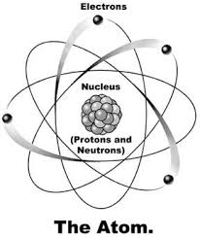
What is a nuclear reaction?
Any reaction that causes a change in the nucleus of an atom.
Radioactive Decay (alpha, beta, gamma)
Fission
Fusion

Slide 2
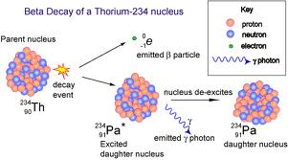
What is Radioactive Decay?
Natural break down of the unstable isotope of an element creating a new element.
Gives off alpha, beta, and/or gamma radiation

Slide 4
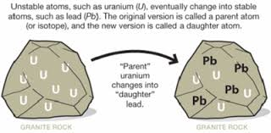
What is Half-Life?
The amount of time it takes for one half of a radioactive isotope to decay to a new element.

Slide 5
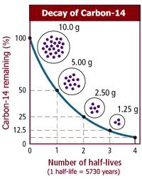
Graphing Half-Life
Graph shows an initial rapid decay that slows over time.

Slide 6
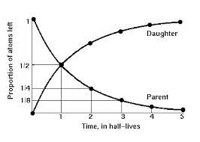
Graphing Half-Life

Slide 7
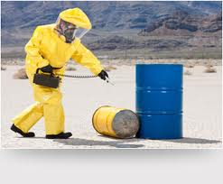
What is a Geiger Counter?
Instrument used to measure radiation.

Slide 8
When is a radioactive element safe?
After 10 half-live
Amount of radiation becomes too low to measure so considered safe

Slide 9
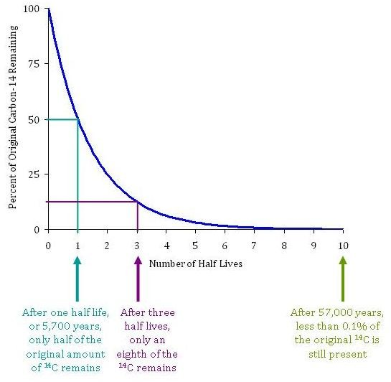
When is a radioactive element safe?

Slide 10
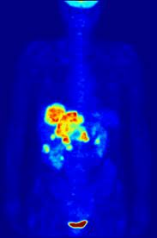
What are the uses of radioactive decay?
1. Nuclear Medicine
Radiation Therapy for Cancer:
gamma radiation kills cancer cells
Radio tracers:
radioactive drugs give off
radiation so path of drug is followed

Slide 11
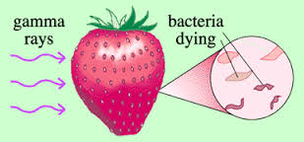
What are the uses of radioactive decay?
2. Food Preservation
Gamma radiation kills bacteria cells on food

Slide 12
What are the uses of radioactive decay?
3. Carbon-14 Dating
Living things contain Carbon-14
When they die it decays to Nitrogen-14
Half-life is 5730 years
By measuring the amount of Carbon-14 left in fossil the age of fossil is determined

Slide 13
Carbon-14 Dating

Slide 14
Carbon-14 Dating

Slide 15
What is Fission?
Man-made nuclear reaction
“Splitting of the Atom”
Large nucleus splits into 2 smaller nuclei
Releases large amount of energy

Slide 16
Fission Reaction

Slide 17
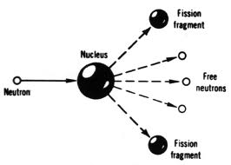
Fission Reaction
Draw this:

Slide 18
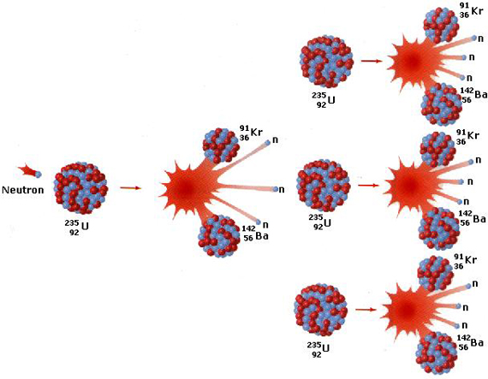
What are Fission Reactions Used for?
1. Atomic Bomb – uncontrolled chain reaction

Slide 19
Atomic Bomb

Slide 20
What are fission reactions used for?
2. Nuclear Power Plants – controlled chain reaction that can generate electricity
-nuclear reaction used to supply heat to make steam
- compared to coal burning power plants there is less air pollution

Slide 21
Nuclear Power Plant

Slide 22
Compared to Coal Burning Power Plant

Slide 23
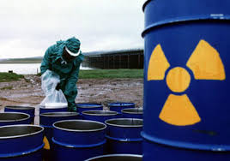
What are the problems with a fission nuclear power plant?
Radioactive waste that is dangerous for thousands of years
Accidents could release large amounts of radioactive material into the environment

Slide 24
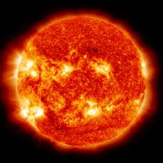
What is a fusion reaction?
Nuclear reaction that occurs in the sun
How all elements are created
Two (2) small nuclei fuse (join together) to form a large nucleus
Gives off tremendous energy

Slide 25
Fusion Reaction

Slide 26
Fusion Reaction Draw this -

Slide 27
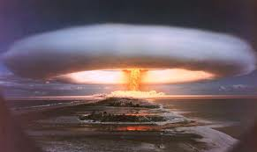
Are there man-made fusion reactions?
Yes
Hydrogen bomb
Research on use for power plants to make electricity

Slide 28
What are the problems with fusion nuclear power plants?
Extremely high temperatures needed melt all containers

Slide 29
Fission vs Fusion

