Slide 1
What is Chemistry?
The study of matter and
how matter can change.

Slide 2
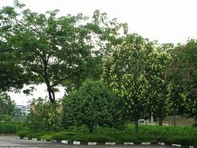
What is Matter?
Anything that has mass and volume (takes up space.) Everything on Earth!

Slide 3
What is mass?
Amount of matter contained in an object. (count the atoms!)
Determined by comparing to a standard like a 1 kg cube of platinum

Slide 4
What is Weight?
The mass of something times the force of gravity.
Less gravity – weigh less!

Slide 5
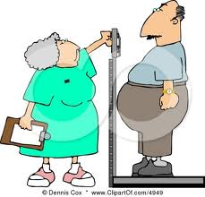
The measurement of weight is based on the pushing or pulling down of a standardized spring scale.

Slide 6
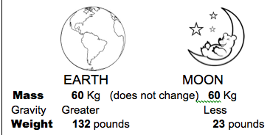
The moon has less gravity than Earth – go there and you weigh less.

Slide 7
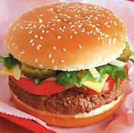
How do we identify matter?
Matter has properties.

Slide 8
What are the Properties of Matter?
Properties are used to describe matter.
Ex. The color, shape, or size of something.

Slide 9
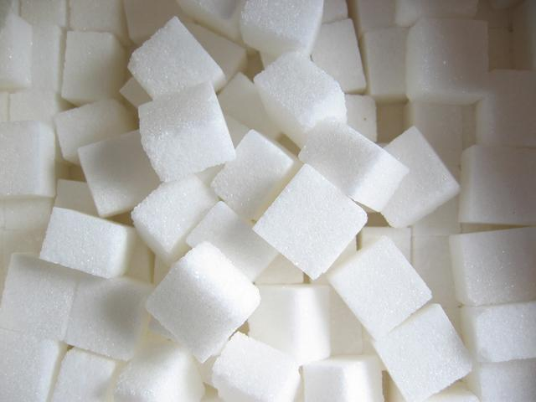
What are the properties of matter?
Two main categories: Physical properties and Chemical properties

Slide 10
What is a physical property of matter?
It can be observed without causing a change in the chemical make-up of the substance.

Slide 11
Examples:
Color Density (mass/volume)
Hardness Boiling Point (temperature it boils)
Odor Melting Point (temperature it melts)
Luster (Shine) Freezing Point (temperature it freezes)
State of Matter Solubility
(solid,liquid,gas) (going into solution)

Slide 12
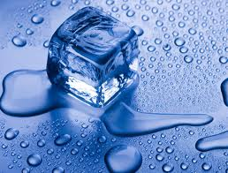
What is a physical change?
The substance can change form or appearance, but the chemical make-up and properties are the same
(i.e. it has the same melting point, boiling point, chemical composition, etc.)

Slide 13
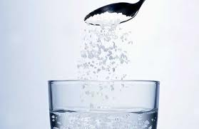
Examples:
change in state: solid ice melts, becomes liquid water Still H₂O
going into solution: salt dissolves in water, still NaCl
change in size – cutting something into pieces

Slide 14
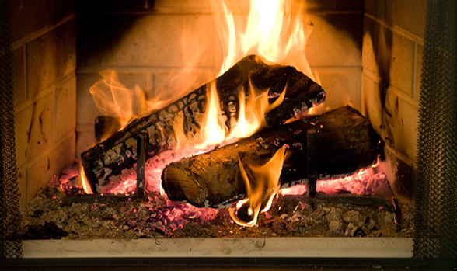
What is a chemical property?
A substance’s ability to change into something else

Slide 15
Examples:
Being Flammable (combustion- ability to catch on fire)
Able to react with other chemicals like acids or bases

Slide 16
What is a chemical change?
The atoms of a substance rearrange to form a new substance with different Properties

Slide 17
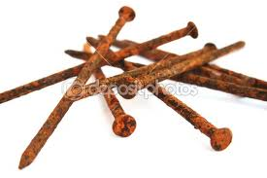
Example:
Iron + Oxygen → Rust
Wood + Oxygen → Burning (combustion) → Carbon Dioxide + H₂O

Slide 18
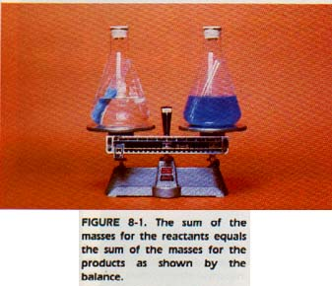
What is the Law of Conservation of Mass?
Matter is neither created nor destroyed in any process

Slide 19
What is a chemical reaction?
Another name for chemical change written as an equation, showing the Law of Conservation of Mass – same number of atoms on both sides of arrow
Reactants → Products
4Fe + 3O₂ → 2Fe₂O₃

Slide 20
Copy heading on student notes
Add: States of matter in title

Slide 21
STATES OF MATTER
Solid, Liquid, Gas and Plasma

Slide 22
What are states of matter?
A physical property in which the substance changes its form as energy is added or taken away. Common “states” or form of matter:
Solid
Liquid
Gas
Plasma

Slide 23
What is a Solid?

Slide 24
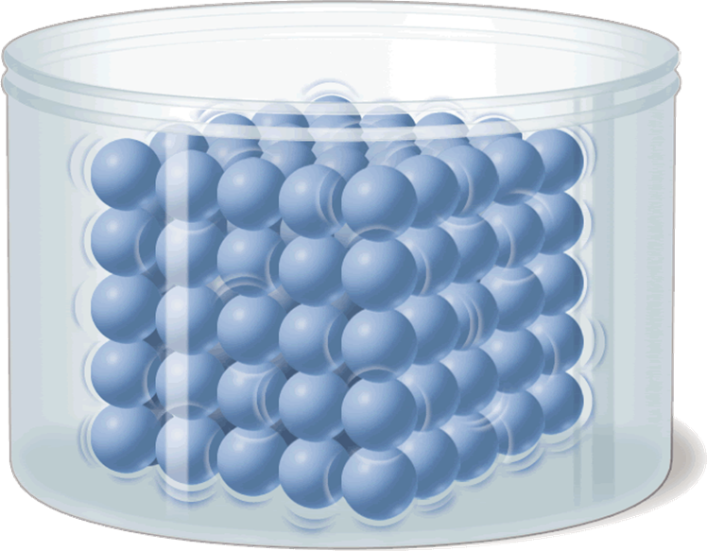
What is a Solid?
EXTENSIVE PROPERTIES | BEHAVIOR OF PARTICLES | DRAWING OF PARTICLES
Volume: Cannot Change | Motion: Vibrate only
Shape: Cannot Change | Distance: Closely packed
Fluid? No | Energy: Lowest Amount

Slide 25
What is a Liquid?

Slide 26
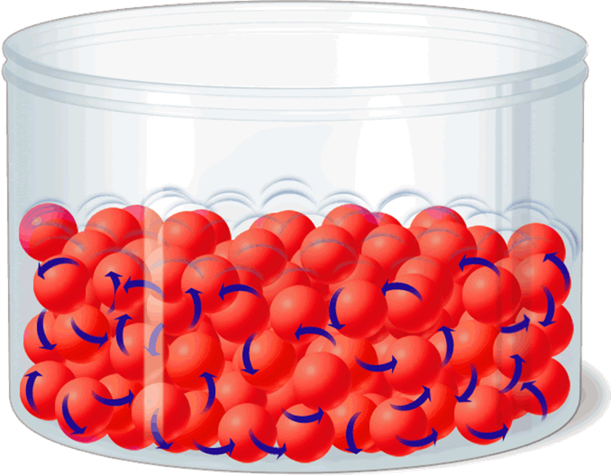
What is a Liquid?
EXTENSIVE PROPERTIES | BEHAVIOR OF PARTICLES | DRAWING OF PARTICLES
Volume: Cannot Change | Motion: Can move around
Shape: CAN Change | Distance: Close together (always touching)
Fluid? Yes | Energy: More than solid

Slide 27
What is a Gas?

Slide 28
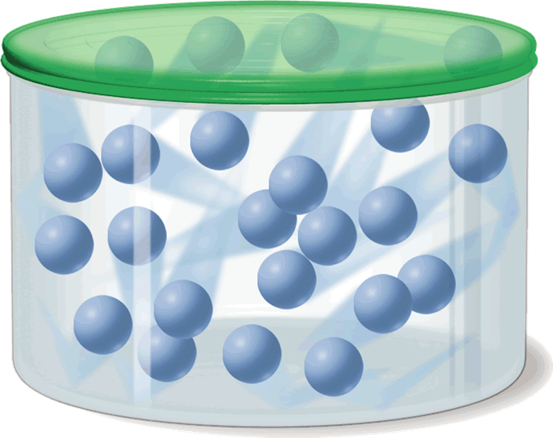
What is a Gas?
EXTENSIVE PROPERTIES | BEHAVIOR OF PARTICLES | DRAWING OF PARTICLES
Volume: CAN Change | Motion: Move Around
Shape: CAN Change | Distance: Far Apart!
Fluid? YES | Energy: More energy than Liquid

Slide 29
What is a Plasma?

Slide 30
What is a Plasma? Like a gas, with positive and negative particles
EXTENSIVE PROPERTIES | BEHAVIOR OF PARTICLES | DRAWING OF PARTICLES
Volume: CAN Change | Motion: Move Around
Shape: CAN Change | Distance: Far Apart!
Fluid? YES | Energy: More energy than Gas
_
+
+
_
+
_
+
+

Slide 31
Change in State
Evaporation, Condensation, Melting, Freezing

Slide 32
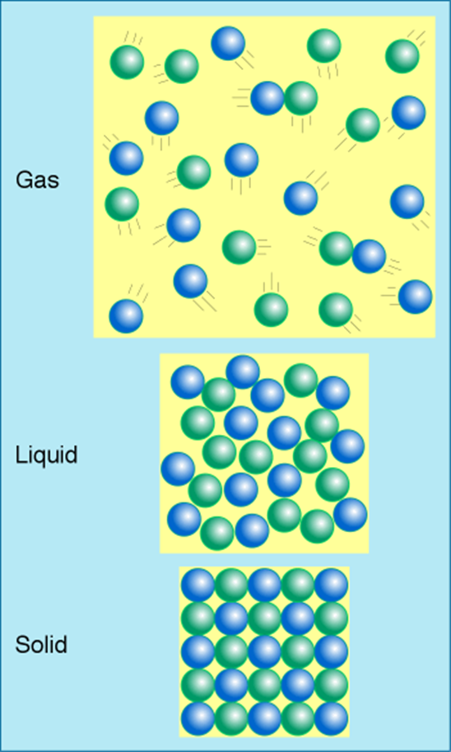
Increase in Energy (Heat)
Condensation
Evaporation
Freezing
Melting

Slide 33
Changes between State
If enough time – video clip

Slide 34
More to Know about Matter!

Slide 35
What is a pure substance?
Made of only one type of matter.
It’s the same throughout the sample.
It has definite properties

Slide 36
What are the types of pure substances?
Elements and Compounds

Slide 37
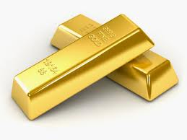
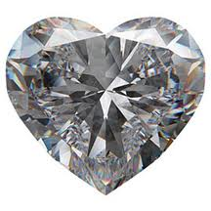
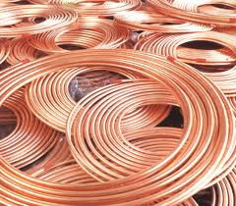
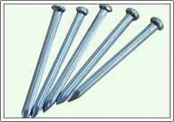
What is an Element?

Slide 38
What is an Element?
Elements – matter made of all the same types of atoms
Chart of Elements is called the Periodic Table
Examples: Copper (Cu), Carbon (C), Sodium (Na), Chlorine (Cl)

Slide 40
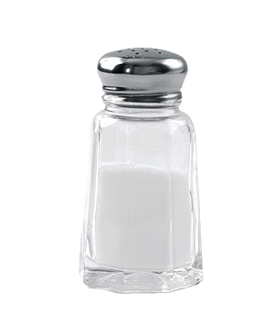
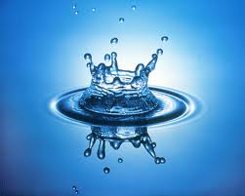
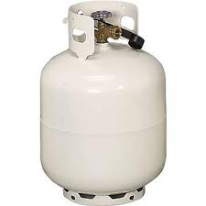
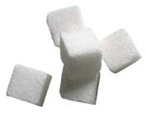
What is a Compound?

Slide 41
What is a Compound?
Compounds – matter made of two or more types of atoms (elements) that are bonded together (also called molecules)
Most matter in the world is in the form of compounds
Examples: Water (H₂O), Sugar (C₆H₁₂O₆)

Slide 42
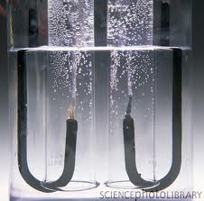
2H₂O ➔ O₂ + 2H₂

Slide 43
How are Elements and Compounds different?
Elements cannot be chemically broken down any further.
Compounds can be chemically broken down into Elements.

Slide 44
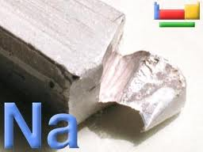
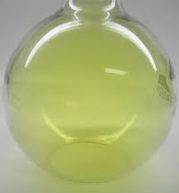
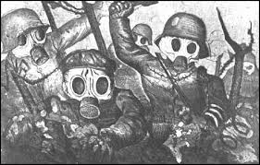
2Na + Cl₂ ➔ 2NaCl
✚
➔

Slide 45
Do elements and compounds have the same properties?
Properties of compounds are different from the properties of the elements they are made of.
Example: Salt is made from sodium metal and toxic chlorine gas

Slide 46
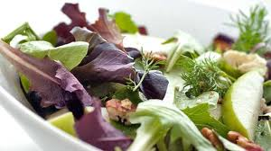
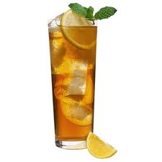
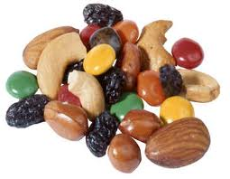
What is a mixture?

Slide 47
What is a mixture?
Two or more substances “mixed” together

Slide 48
Do the parts of a mixture lose their properties?
NO! There is no bonding in a mixture.
The substances in the mixture keep their individual properties.

Slide 49
Can the parts of a mixture be separated?
YES! The physical properties of the substances can be used to separate them from the mixture.
Example: Salt in water – evaporate the water away and get the salt back

Slide 50
What is a mixture?

Slide 51
Are there different types of mixtures?
Yes -
Homogeneous and Heterogeneous

Slide 52
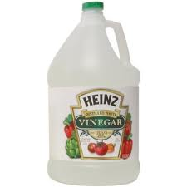
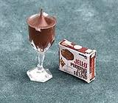
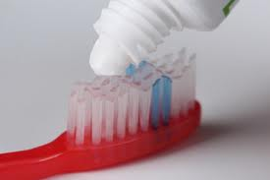
What is a homogeneous mixture?

Slide 53
What is a homogeneous mixture?
The mixture looks the same throughout.
Example: Salt in water – can’t see the salt – looks like clear water
coffee, tea, toothpaste,

Slide 54
What is a solution?
A type of homogeneous mixture, like salt in water.

Slide 55
Is it easy to separate the parts of a homogeneous mixture?
NO! It takes a lot of energy
Example: Salt in water – must boil the water away from the salt

Slide 56
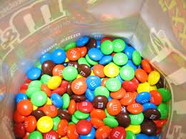
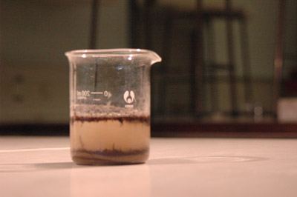
What is a heterogeneous mixture?

Slide 57
What is a heterogeneous mixture?
The mixture does not look the same throughout. You can see the different substances.
Example: Oil and Water, Sand and Water

Slide 58
Is it easy to separate the parts of a heterogeneous mixture?
YES It does not take a lot of energy.
Example: Decant (pour off) the oil way from the water. Filter the sand away from the water.

Slide 59
http://www.bbc.co.uk/bitesize/ks3/science/chemical_material_behaviour/compounds_mixtures/activity/

Slide 60
On bottom of page add: Matter Flowchart
MATTER
yes
no
Can it be physically separated?
MIXTURE
PURE SUBSTANCE
yes
Is the composition uniform?
no
yes
Can it be chemically decomposed?
no
Homogeneous Mixture
(solution)
Heterogeneous Mixture
Compound
Element
Colloids
Suspensions

