Slide 1
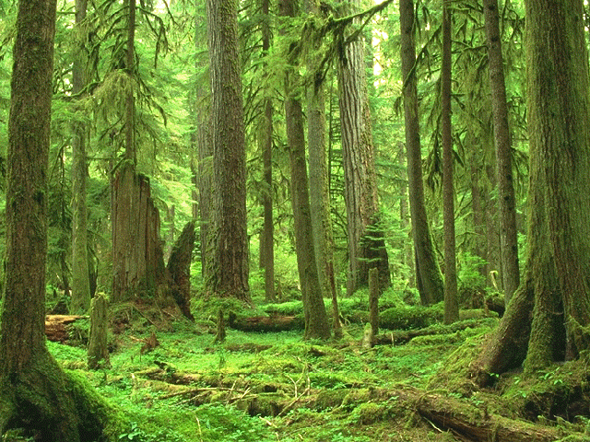
Forest Density

Slide 2
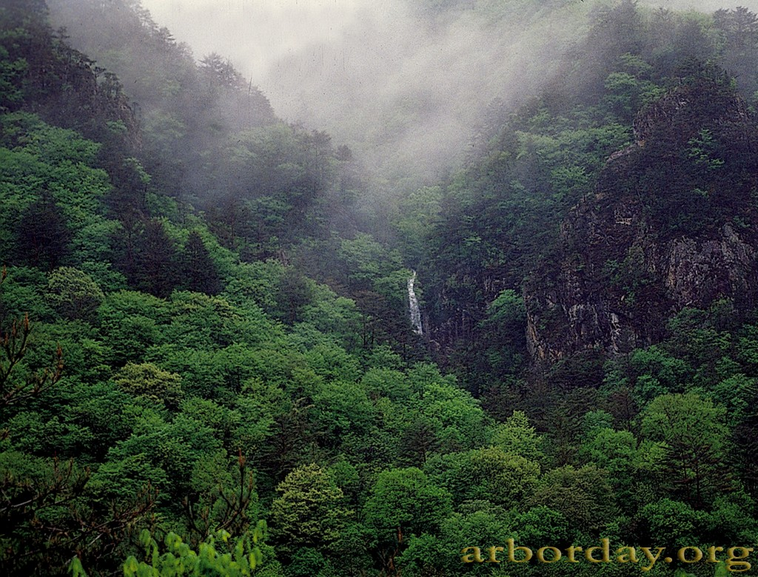
Forest Density

Slide 3
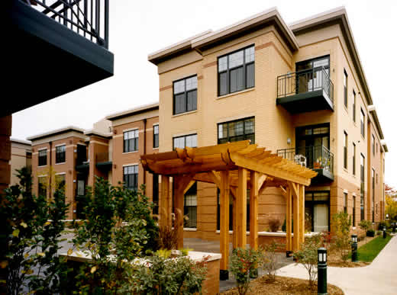
Housing Density

Slide 4
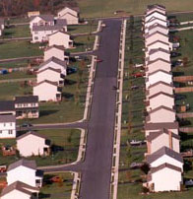
Housing Density

Slide 5
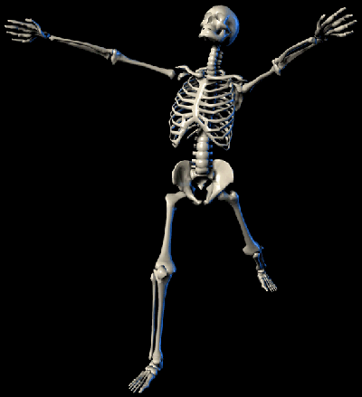
Bone Density

Slide 6
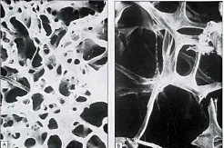
Bone Density

Slide 7
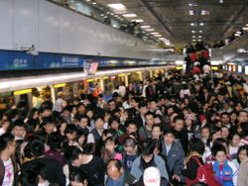
Population Density

Slide 8
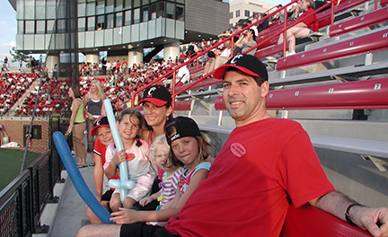
Population Density

Slide 9
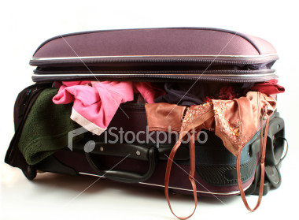
1st principle of density

Slide 10
1st principle of density
If you pack more mass into the same volume, it becomes more dense

Slide 11
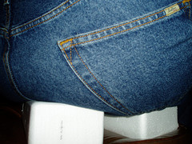
2nd principle of density

Slide 12
2nd principle of density
If you pack the same mass into a smaller volume, it becomes more dense

Slide 13
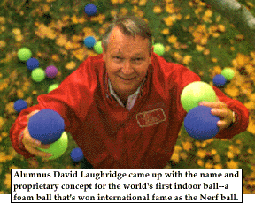

3rd principle of density

Slide 14
3rd principle of density
Just because something has more mass doesn’t mean it is more dense.

Slide 15
Density
Notes

Slide 16
Which one is more dense?
Demonstration: People in a square
How about this: Which square is more dense?

Slide 17
Which one is more dense?
Now which one is more dense?

Slide 18
What is density?
Density is a comparison of how much matter there is in a certain amount of space.

Slide 19
What is density?
Ratio of its mass per volume
It is a characteristic property – you can use it to identify an unknown substance
For any substance, it is ALWAYS the same, regardless of the size of the substance

Slide 20
What is density?
Density = mass
volume
OR mass ÷ volume.
Units for density: g or g
cm³ ml
ALWAYS REMEMBER UNITS!
cm³ = mL = cc

Slide 21
What is density?
D = m /V
m
V = m /D
D
V
m = D X V

Slide 22
Let’s try a density problem together
Frank has a paper clip. It has a mass of 9g and a volume of 3cm³. What is its density?
Frank also has an eraser. It has a mass of 3g, and a volume of 1cm³. What is its density?

Slide 23
Liquid Layers
If you pour together liquids that don’t mix and have different densities, they will form liquid layers.
The liquid with the highest density will be on the bottom.
The liquid with the lowest density will be on the top.

Slide 24
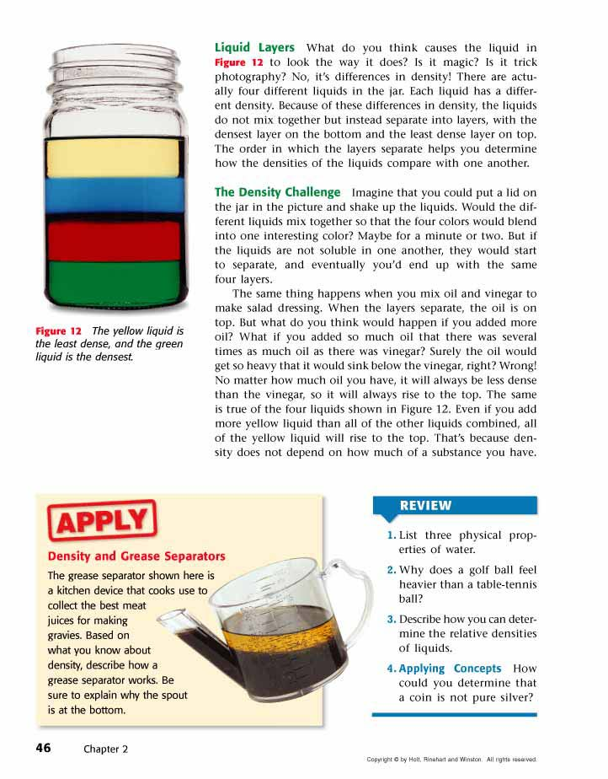
Liquid Layers
Check out this picture. Which layer has the highest density?
Which layer has the lowest density?
Imagine that the liquids have the following densities:
  10g/cm³. 3g/cm³.
  6g/cm³. 5g/cm³.
Which number would go with which layer?

Slide 25
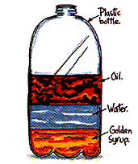
Liquid Layers – Try with your neighbor
Which liquid has the highest density?
Which liquid has the lowest density?
Which liquid has the middle density?

Slide 26
Super Scientist Question of the Day
Jake has a book, a ruler, and a balance.
How can Jake find the density of the book with the tools he has?

