Slide 1
Chemical Reactions & Equations
Zn + I₂
Reactants
Zn I₂
Product

Slide 2
There are millions of chemical reactions. The only way to be sure what your products will be is to carry them out in the lab!
Not very practical – or cost effective, however…

Slide 3
Types of Reactions
There are five types of chemical reactions we can make some predictions for:
  Synthesis reactions
  Decomposition reactions
  Single Replacement reactions
  Double Replacement reactions
  Combustion reactions
You need to be able to identify the type of reaction and predict the product(s)

Slide 4
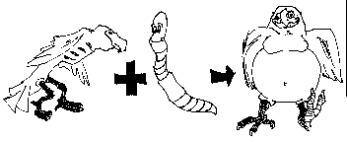
1. Synthesis reactions
Synthesis reactions occur when two or more substances (generally elements) combine to form a single compound.
(Sometimes these are called combination reactions.)
reactant + reactant → 1 product
Basically: A + B → AB

Slide 5
Example #1: 2H₂ + O₂ → 2H₂O
Reactants
Products
Notes:
5

Slide 6
Example #2
2Mg + O₂ → 2 MgO
Mg
O
Mg²⁺
O²⁻
O
Mg
O²⁻
Mg²⁺
General form: A + B → AB
element or element or compound
compound compound

Slide 7
1. Synthesis reactions
Practice
Na (s) + Cl₂ (g) → ?

Slide 8
1. Synthesis reactions
Practice
2Na (s) + Cl₂ (g) → 2NaCl (s)

Slide 9
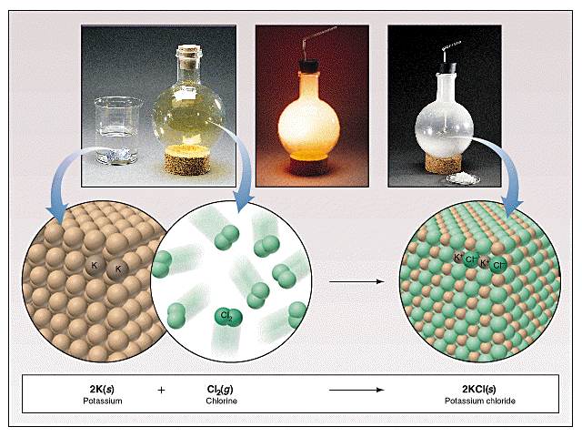
Another synthesis reaction

Slide 10
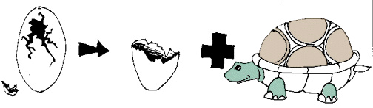
2. Decomposition Reactions
Decomposition reactions occur when a single compound breaks up into one or more simpler substances
1 Reactant → Product + Product
Basically: AB → A + B

Slide 11
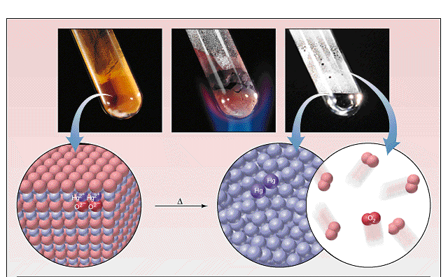
Example #1
2HgO(s) → 2Hg(l) + O₂(g)

Slide 12
Example #2:
2H₂O₂ → 2H₂O + O₂ video clip elephant toothpaste

Slide 13
Practice
Solid Lead (IV) oxide decomposes
PbO_{2(s)} →

Slide 14
Practice
Solid Lead (IV) oxide decomposes
PbO_{2(s)} → Pb(s) + O₂ (g)

Slide 15
Practice
Identify the type of reaction for each of the following as synthesis or decomposition N_{2(g)} + O_{2(g)} →
BaCO_{3(s)} → BaO(s) + CO₂(g)
2NO

Slide 16
Practice
Identify the type of reaction for each of the following as synthesis or decomposition N_{2(g)} + O_{2(g)} →
BaCO_{3(s)} → BaO(s) + CO₂(g)
Decomposition
2NO Synthesis

Slide 17
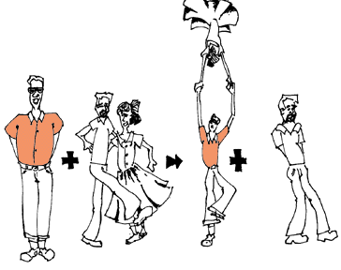
3. Single Replacement Reactions
Single Replacement Reactions occur when one element replaces another in a compound.
Element + Compound→ Compound + Element
  A + BC → AC + B
.

Slide 18
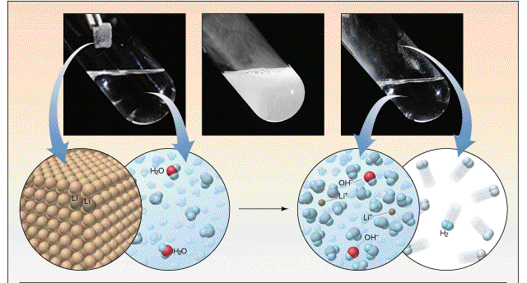
Example #1
2Li_{(s)} + 2H₂O_{(l)} → 2LiOH_{(aq)} + H_{2(g)}

Slide 19
Example #2
Mg + CuSO₄ MgSO₄ + Cu
Single Replacement Reaction
Mg + CuSO₄ → MgSO₄ + Cu
General form:
A + BC → AC + B

Slide 20
Practice
Ni + NaCl →

Slide 21
Practice
Ni + NaCl → NiCl + Na

Slide 22
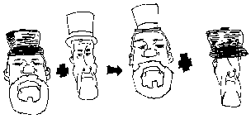
4. Double Replacement Reactions
The ions of two compounds exchange places in an
aqueous solution to form two new compounds.
compound + compound → compound + compound
AB + CD → AD + CB
One of the products formed is usually a
precipitate, an insoluble gas that bubbles out of
solution, or a molecular compound, usually water.

Slide 23
Example #1
CaCO₃ + 2HCl → CaCl₂ + H₂CO₃
CaCO₃ + 2 HCl → CaCl₂ + H₂CO₃
Double-replacement reaction
General form:
AB + CD → AD + CB

Slide 24
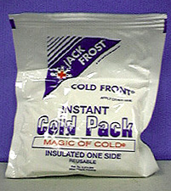
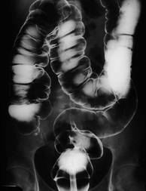

Ba(OH)₂.8H₂O(s ) + 2 NH₄SCN(s ) --> Ba(SCN)₂(s ) + 10 H₂O(l ) + 2 NH₃(g )
Ba
O
O
O
Ca
H
H
O
S
O
O
Example #2
Ba(OH)_{2(aq)} + CaSO_{4(aq)} → BaSO_{4(s)} + Ca(OH)_{2(aq)}

Slide 25
Practice
Predict the products. Balance the equation
HCl_{(aq)} + Ag(NO₃)_{(aq)} →

Slide 26
Practice
Practice: Predict the products. Balance the equation
HCl_{(aq)} + Ag(NO₃)_{(aq)} → H(NO₃)_{(aq)} + AgCl_{(s)}

Slide 27
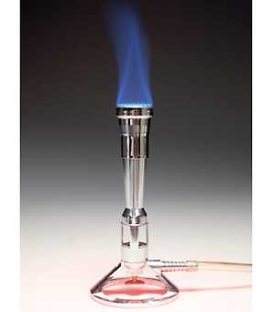
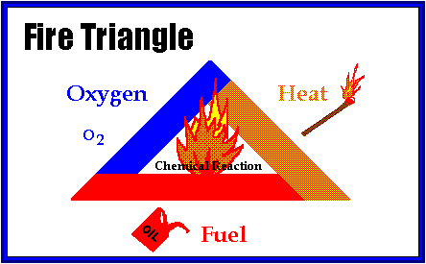
5. Combustion Reactions
Combustion reactions occur whenever something reacts with oxygen gas.
This is also called burning!!!

Slide 28


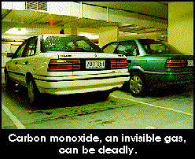
Products are ALWAYS carbon dioxide and water.
In general:
C_{x}H_{y} + O₂ → CO₂ + H₂O

Slide 29
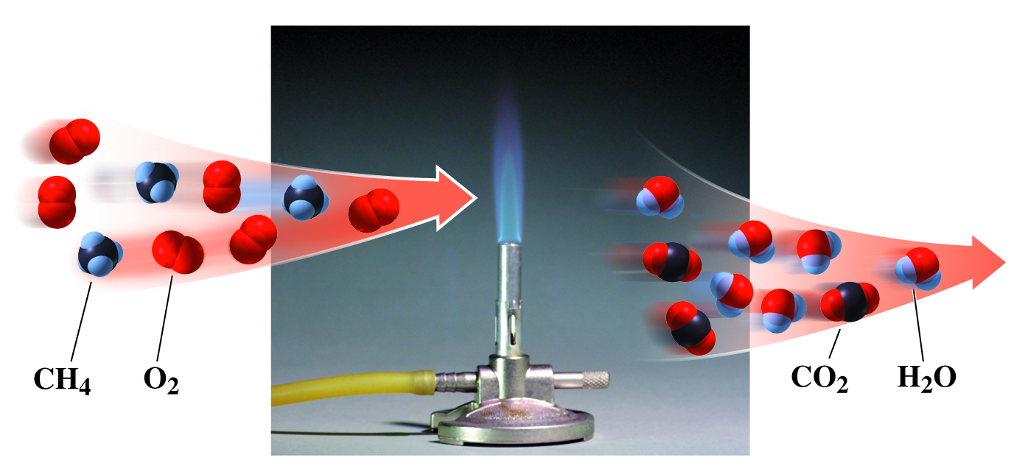
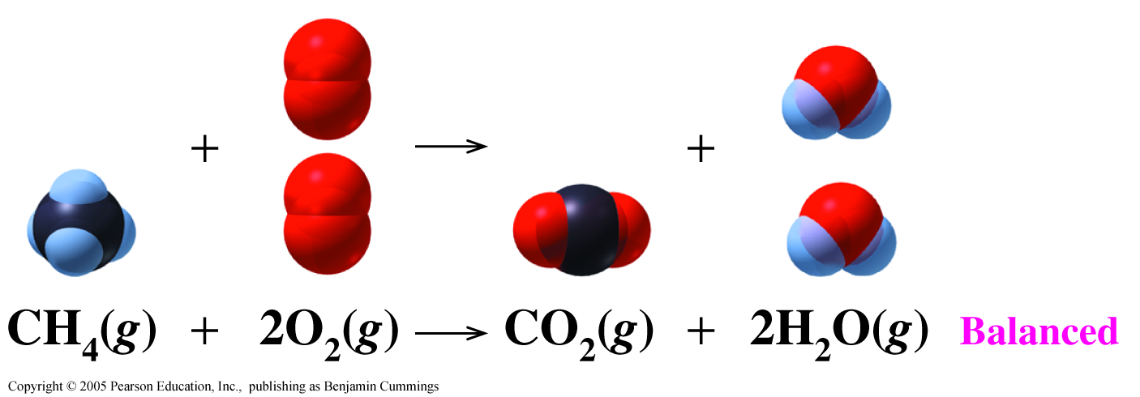
Example #1
CH₄ _{(g)} + 2O₂ _{(g)} → CO₂ _{(g)} + 2H₂O_{(l)}
Notes:
29

Slide 30
Summary
Video clip five Major Chemical Reactions

Slide 31
Mixed Practice
State the type of reaction
BaCl₂ + NaSO₄ → Ba(SO₄) + 2NaCl
C₆H₁₂ + 9O₂ → 6CO₂ + 6H₂O
Zn + Cu(SO₄ ) → Zn(SO₄ ) + Cu
Cs + Br₂ → 2CsBr
2NaCl → Na + Cl₂

Slide 32
Mixed Practice
State the type of reaction
1. BaCl₂ + NaSO₄ → Ba(SO₄) + 2NaCl
Double Replacement
2. C₆H₁₂ + 9O₂ → 6CO₂ + 6H₂O
Combustion

Slide 33
Mixed Practice
State the type of reaction
Zn + Cu(SO₄ ) → Zn(SO₄ ) + Cu
Single Replacement
Cs + Br₂ → 2CsBr
Synthesis
2NaCl → Na + Cl₂
_{Decomposition}

