Slide 1
Bonding Guided Notes #1 (label this page #4- with a circle) (see my website if you don’t know what assignments 1, 2, and 3 were- binder quiz Tuesday!)

Slide 2
Electrons
Electrons are the only ___stable__ subatomic particles directly involved in chemical reactions.

Slide 3
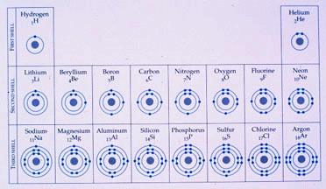
Electron Configuration
Electron configuration = Distribution of electrons in an atom's electron _shell___ (orbitals).

Slide 4
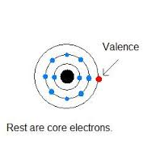
How electrons are distributed
If an atom does not have enough __electrons___ to fill all shells, the outer shell will be the only one partially filled.

Slide 5
Chemical properties
Chemical properties of an atom depend upon the number of ___valence_electrons____.
Example- Group 1 all the elements are highly reactive to H₂0.
(remember the video- explosions, fire)

Slide 6
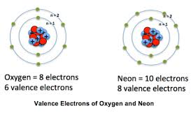
Valence Electrons
Valence electrons = Electrons in the atom’s _outermost__ energy shell.

Slide 7
You can tell how many valence electrons there are in each atom by looking at its __Group #_.

Slide 8
How many valence electrons are there? *As you can see you “ignore” the 1 in Groups 13-18)
Group # | # of valence electrons
1 | 1
2 | 2
13* | 3
14* | 4
15* | 5
16* | 6
17* | 7
18* | 2 (for period 1 ONLY) 8 (noble gases already have a full energy shell!)

Slide 9
Practice:
Practice- How many valence electrons does K have? (Hint- what group # is K in?) _______
Practice- How many valence electrons does C have? _______

Slide 10
Practice:
Practice- How many valence electrons does K have? (Hint- what group # is K in?) _1(group 1)
Practice- How many valence electrons does C have? ___4__(group 14)

Slide 11
Full vs Partial Shells
An atom with a complete valence shell is ____unreactive___ or inert.
An atom with an ___incomplete____ valence shell is chemically reactive (tends to form chemical bonds until it has 8 electrons to fill the valence shell).

Slide 12
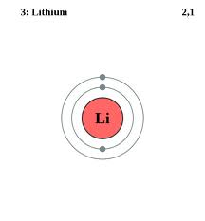
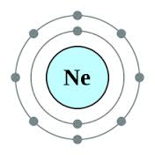
Valence Shells
Octet rule = Rule that a valence shell is ____full/complete_ when it contains 8 electrons (except H and He in Period 1).
Partial valence shell Full valence shell

Slide 13
Why do they have partial or full shells?
Li has __1__ valence electrons and Ne has __8__ valence electrons.
*Remember you need 8 electrons for an atom to be ___stable and complete__.
(This means Ne is full and cannot use Li’s valence electron)

Slide 14
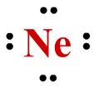
Lewis Dot Diagrams
A Lewis structure is a structural representation of a molecule where dots are used to show __electron_ position around the __atom_.
(compare the valence electron pictures to these pictures)

Slide 15
Ionization energy
Ionization energy is a measure of the difficulty of ___removing an___ electron or the strength by which an electron is bound.
The higher the ionization energy, the more __difficult___ it is to remove an electron.
*Remember as you go from _left__ to _right_ across the periodic table it becomes more and more difficult to remove an electron.

Slide 16
Cation
A cation is an ion with a ____positive___charge and is formed when an atom ___gives/loses___ one or more electrons.
(It is pronounced… “cat ion”)
Groups 1, 2, and 13 tend to be ___cations__.

Slide 17
Anion
An anion is an ion with a __negative__charge and is formed when an atom ___takes___ one or more electrons.
(It is pronounced- “ann ion”)
Groups 15, 16 and 17 tend to be __anions__.
*Hit think anion looks like the word onion= negative and negative people “take” things*

Slide 18
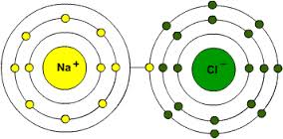
Ionic bond between Na and Cl… yummy salt! Na has 1 valence electron to “give” away Cl has 1 spot before it is full. It “takes” Na’s valence electron.

Slide 19
Practice (anion or cation)
Is Ca a cation or an anion? (Hint- what is Ca’s group #?)__________
Is F a cation or an anion? __________

Slide 20
Practice (anion or cation)
Is Ca a cation or an anion? (Hint- what is Ca’s group #?)
Calcium is in Group 2, which makes it a cation
Is F a cation or an anion?
Fluorine is in Group 17, which makes it an anion.

